Slide 1


sss
Spring Security
A hands-on workshop

Slide 2






laurspilca.com/blog
youtube.com/c/laurentiuspilca
@laurspilca
Laurentiu Spilca
Notes:
Elements (version 1)
Elements are used to give more detail to a set of ideas, they should all relate to the same topic.
For example, use this page for a list of deliverables, key roles on a project, phases of a project, or any topic that can be broken down into more specific examples.
Each section should have an icon that relates to the content of that specific element, no icon should be repeated on the same page, and they should all be the same colour.
Keep the text to 1-2 sentences and aim to have about the same amount of content under each element.

Slide 3

Notes:
Elements (version 1)
Elements are used to give more detail to a set of ideas, they should all relate to the same topic.
For example, use this page for a list of deliverables, key roles on a project, phases of a project, or any topic that can be broken down into more specific examples.
Each section should have an icon that relates to the content of that specific element, no icon should be repeated on the same page, and they should all be the same colour.
Keep the text to 1-2 sentences and aim to have about the same amount of content under each element.

Slide 4
Security.
1
Notes:
Chapter Intro Slide (version P)
This slide should be used at the beginning of each “chapter” of your presentation (as introduced in the Agenda slide) to keep the audience aware of their place in the story and to help break things up. Change the text and chapter number accordingly. If you do not need a sub-head (the smaller text), delete it. Use different backgrounds for different chapter titles, try not to repeat a background.
Very short presentations (< ~10 slides) may not need Chapter Intro Slides.
There are multiple versions of this template with various white and black background images starting on slide 10.

Slide 5

privacy
injection
Security
gateway
OpenID
authentication
secret
signature
crypto
authorization
network
OAuth
credentials
DDOS
key pairs
attack
intercepting
CORS
CSRF
password
JWT
private
MITM
auditing
1
Notes:
Chapter Intro Slide (version P)
This slide should be used at the beginning of each “chapter” of your presentation (as introduced in the Agenda slide) to keep the audience aware of their place in the story and to help break things up. Change the text and chapter number accordingly. If you do not need a sub-head (the smaller text), delete it. Use different backgrounds for different chapter titles, try not to repeat a background.
Very short presentations (< ~10 slides) may not need Chapter Intro Slides.
There are multiple versions of this template with various white and black background images starting on slide 10.

Slide 6

Spring Security
1. Basic architecture
2. The filter chain
3. Global method security
4. Security configurations in Spring Reactive apps
5. Implementing an OAuth 2 system
6. The new authorization server
7. Integration testing for Spring Security
1
Notes:
Chapter Intro Slide (version P)
This slide should be used at the beginning of each “chapter” of your presentation (as introduced in the Agenda slide) to keep the audience aware of their place in the story and to help break things up. Change the text and chapter number accordingly. If you do not need a sub-head (the smaller text), delete it. Use different backgrounds for different chapter titles, try not to repeat a background.
Very short presentations (< ~10 slides) may not need Chapter Intro Slides.
There are multiple versions of this template with various white and black background images starting on slide 10.

Slide 7
Basic architecture.
1
Notes:
Chapter Intro Slide (version P)
This slide should be used at the beginning of each “chapter” of your presentation (as introduced in the Agenda slide) to keep the audience aware of their place in the story and to help break things up. Change the text and chapter number accordingly. If you do not need a sub-head (the smaller text), delete it. Use different backgrounds for different chapter titles, try not to repeat a background.
Very short presentations (< ~10 slides) may not need Chapter Intro Slides.
There are multiple versions of this template with various white and black background images starting on slide 10.

Slide 8
The filter chain.
1
Notes:
Chapter Intro Slide (version P)
This slide should be used at the beginning of each “chapter” of your presentation (as introduced in the Agenda slide) to keep the audience aware of their place in the story and to help break things up. Change the text and chapter number accordingly. If you do not need a sub-head (the smaller text), delete it. Use different backgrounds for different chapter titles, try not to repeat a background.
Very short presentations (< ~10 slides) may not need Chapter Intro Slides.
There are multiple versions of this template with various white and black background images starting on slide 10.

Slide 9
Global method security.
1
Notes:
Chapter Intro Slide (version P)
This slide should be used at the beginning of each “chapter” of your presentation (as introduced in the Agenda slide) to keep the audience aware of their place in the story and to help break things up. Change the text and chapter number accordingly. If you do not need a sub-head (the smaller text), delete it. Use different backgrounds for different chapter titles, try not to repeat a background.
Very short presentations (< ~10 slides) may not need Chapter Intro Slides.
There are multiple versions of this template with various white and black background images starting on slide 10.

Slide 10
Security configurations in
Spring Reactive apps.
1
Notes:
Chapter Intro Slide (version P)
This slide should be used at the beginning of each “chapter” of your presentation (as introduced in the Agenda slide) to keep the audience aware of their place in the story and to help break things up. Change the text and chapter number accordingly. If you do not need a sub-head (the smaller text), delete it. Use different backgrounds for different chapter titles, try not to repeat a background.
Very short presentations (< ~10 slides) may not need Chapter Intro Slides.
There are multiple versions of this template with various white and black background images starting on slide 10.

Slide 11
Implementing an OAuth 2 system.
1
Notes:
Chapter Intro Slide (version P)
This slide should be used at the beginning of each “chapter” of your presentation (as introduced in the Agenda slide) to keep the audience aware of their place in the story and to help break things up. Change the text and chapter number accordingly. If you do not need a sub-head (the smaller text), delete it. Use different backgrounds for different chapter titles, try not to repeat a background.
Very short presentations (< ~10 slides) may not need Chapter Intro Slides.
There are multiple versions of this template with various white and black background images starting on slide 10.

Slide 12



Single Sign On
OAuth
SAML
OpenID Connect
1
Notes:
Chapter Intro Slide (version P)
This slide should be used at the beginning of each “chapter” of your presentation (as introduced in the Agenda slide) to keep the audience aware of their place in the story and to help break things up. Change the text and chapter number accordingly. If you do not need a sub-head (the smaller text), delete it. Use different backgrounds for different chapter titles, try not to repeat a background.
Very short presentations (< ~10 slides) may not need Chapter Intro Slides.
There are multiple versions of this template with various white and black background images starting on slide 10.

Slide 13
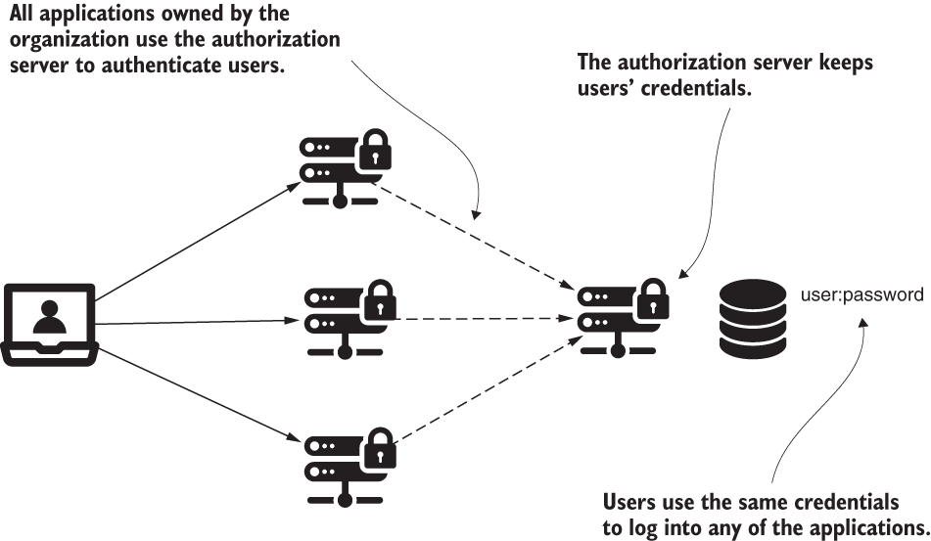
1
Notes:
Chapter Intro Slide (version P)
This slide should be used at the beginning of each “chapter” of your presentation (as introduced in the Agenda slide) to keep the audience aware of their place in the story and to help break things up. Change the text and chapter number accordingly. If you do not need a sub-head (the smaller text), delete it. Use different backgrounds for different chapter titles, try not to repeat a background.
Very short presentations (< ~10 slides) may not need Chapter Intro Slides.
There are multiple versions of this template with various white and black background images starting on slide 10.

Slide 14

The access card.
1
Notes:
Chapter Intro Slide (version P)
This slide should be used at the beginning of each “chapter” of your presentation (as introduced in the Agenda slide) to keep the audience aware of their place in the story and to help break things up. Change the text and chapter number accordingly. If you do not need a sub-head (the smaller text), delete it. Use different backgrounds for different chapter titles, try not to repeat a background.
Very short presentations (< ~10 slides) may not need Chapter Intro Slides.
There are multiple versions of this template with various white and black background images starting on slide 10.

Slide 15


Implicit
Password
Authorization code
Authorization code with PKCE
Client credentials
1
Notes:
Chapter Intro Slide (version P)
This slide should be used at the beginning of each “chapter” of your presentation (as introduced in the Agenda slide) to keep the audience aware of their place in the story and to help break things up. Change the text and chapter number accordingly. If you do not need a sub-head (the smaller text), delete it. Use different backgrounds for different chapter titles, try not to repeat a background.
Very short presentations (< ~10 slides) may not need Chapter Intro Slides.
There are multiple versions of this template with various white and black background images starting on slide 10.

Slide 16
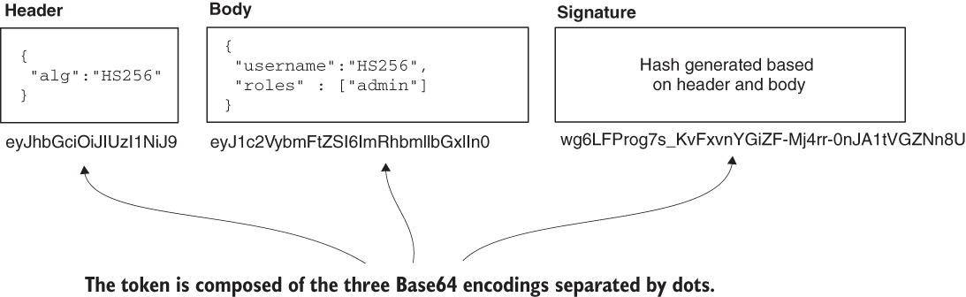
JSON Web Token.
1
Notes:
Chapter Intro Slide (version P)
This slide should be used at the beginning of each “chapter” of your presentation (as introduced in the Agenda slide) to keep the audience aware of their place in the story and to help break things up. Change the text and chapter number accordingly. If you do not need a sub-head (the smaller text), delete it. Use different backgrounds for different chapter titles, try not to repeat a background.
Very short presentations (< ~10 slides) may not need Chapter Intro Slides.
There are multiple versions of this template with various white and black background images starting on slide 10.

Slide 17
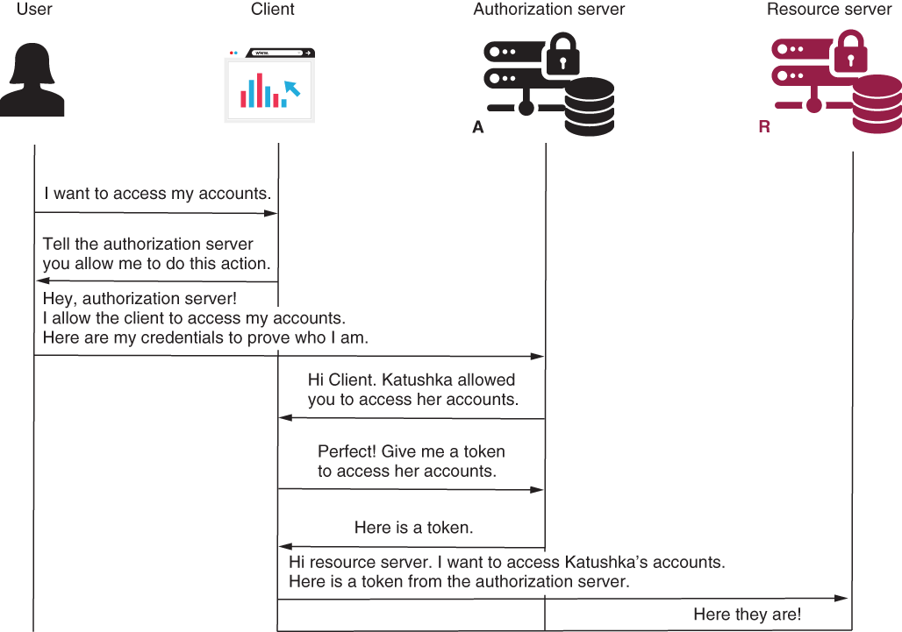
1
Notes:
Chapter Intro Slide (version P)
This slide should be used at the beginning of each “chapter” of your presentation (as introduced in the Agenda slide) to keep the audience aware of their place in the story and to help break things up. Change the text and chapter number accordingly. If you do not need a sub-head (the smaller text), delete it. Use different backgrounds for different chapter titles, try not to repeat a background.
Very short presentations (< ~10 slides) may not need Chapter Intro Slides.
There are multiple versions of this template with various white and black background images starting on slide 10.

Slide 18

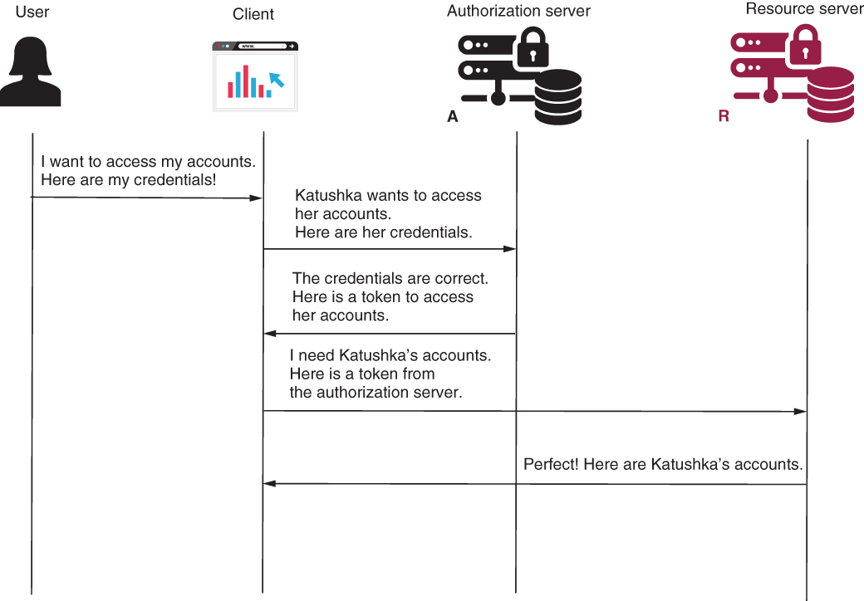
Password
The client gets the credentials.
1
Notes:
Chapter Intro Slide (version P)
This slide should be used at the beginning of each “chapter” of your presentation (as introduced in the Agenda slide) to keep the audience aware of their place in the story and to help break things up. Change the text and chapter number accordingly. If you do not need a sub-head (the smaller text), delete it. Use different backgrounds for different chapter titles, try not to repeat a background.
Very short presentations (< ~10 slides) may not need Chapter Intro Slides.
There are multiple versions of this template with various white and black background images starting on slide 10.

Slide 19
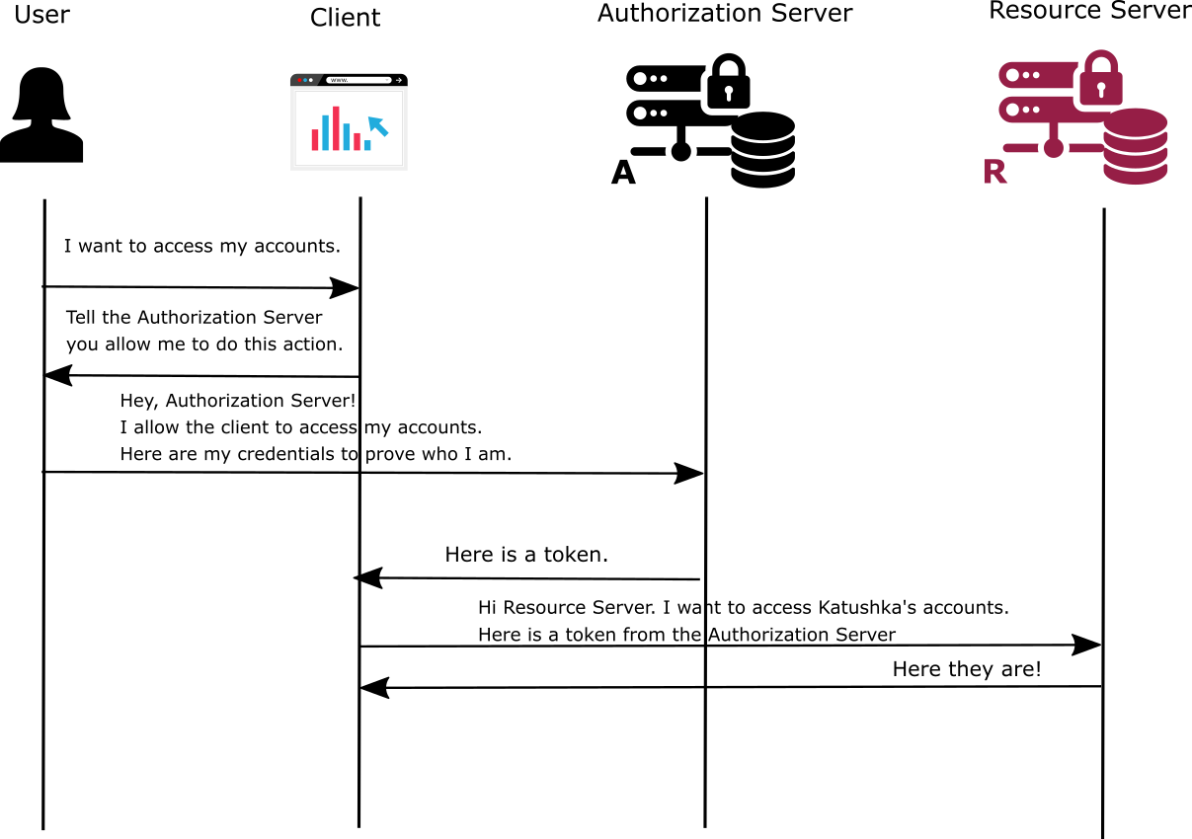
The authorization server might be tricked into sending the access token to someone else.
Implicit
1
Notes:
Chapter Intro Slide (version P)
This slide should be used at the beginning of each “chapter” of your presentation (as introduced in the Agenda slide) to keep the audience aware of their place in the story and to help break things up. Change the text and chapter number accordingly. If you do not need a sub-head (the smaller text), delete it. Use different backgrounds for different chapter titles, try not to repeat a background.
Very short presentations (< ~10 slides) may not need Chapter Intro Slides.
There are multiple versions of this template with various white and black background images starting on slide 10.

Slide 20
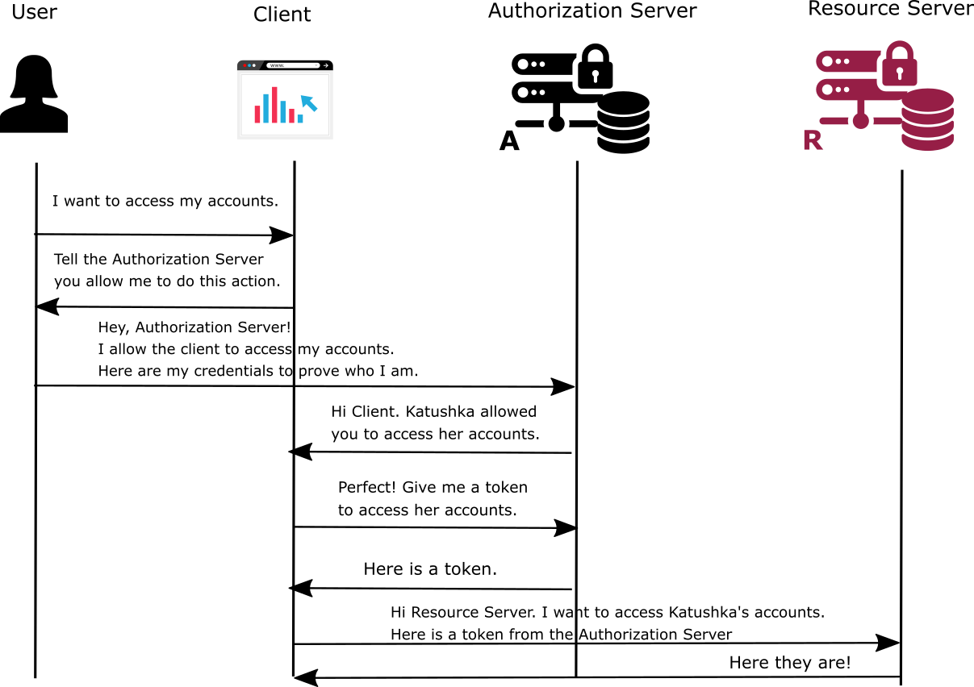
Authorization Code
1
Notes:
Chapter Intro Slide (version P)
This slide should be used at the beginning of each “chapter” of your presentation (as introduced in the Agenda slide) to keep the audience aware of their place in the story and to help break things up. Change the text and chapter number accordingly. If you do not need a sub-head (the smaller text), delete it. Use different backgrounds for different chapter titles, try not to repeat a background.
Very short presentations (< ~10 slides) may not need Chapter Intro Slides.
There are multiple versions of this template with various white and black background images starting on slide 10.

Slide 21
The new authorization server project.
1
Notes:
Chapter Intro Slide (version P)
This slide should be used at the beginning of each “chapter” of your presentation (as introduced in the Agenda slide) to keep the audience aware of their place in the story and to help break things up. Change the text and chapter number accordingly. If you do not need a sub-head (the smaller text), delete it. Use different backgrounds for different chapter titles, try not to repeat a background.
Very short presentations (< ~10 slides) may not need Chapter Intro Slides.
There are multiple versions of this template with various white and black background images starting on slide 10.

Slide 22
Integration testing for Spring Security configurations.
1
Notes:
Chapter Intro Slide (version P)
This slide should be used at the beginning of each “chapter” of your presentation (as introduced in the Agenda slide) to keep the audience aware of their place in the story and to help break things up. Change the text and chapter number accordingly. If you do not need a sub-head (the smaller text), delete it. Use different backgrounds for different chapter titles, try not to repeat a background.
Very short presentations (< ~10 slides) may not need Chapter Intro Slides.
There are multiple versions of this template with various white and black background images starting on slide 10.

Slide 23
Integration testing
1% authentication
99% authorization
1
Notes:
Chapter Intro Slide (version P)
This slide should be used at the beginning of each “chapter” of your presentation (as introduced in the Agenda slide) to keep the audience aware of their place in the story and to help break things up. Change the text and chapter number accordingly. If you do not need a sub-head (the smaller text), delete it. Use different backgrounds for different chapter titles, try not to repeat a background.
Very short presentations (< ~10 slides) may not need Chapter Intro Slides.
There are multiple versions of this template with various white and black background images starting on slide 10.

Slide 24
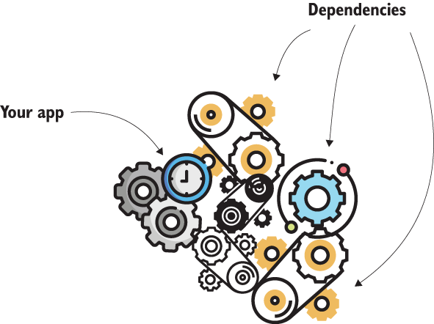
Integration testing
1
Notes:
Chapter Intro Slide (version P)
This slide should be used at the beginning of each “chapter” of your presentation (as introduced in the Agenda slide) to keep the audience aware of their place in the story and to help break things up. Change the text and chapter number accordingly. If you do not need a sub-head (the smaller text), delete it. Use different backgrounds for different chapter titles, try not to repeat a background.
Very short presentations (< ~10 slides) may not need Chapter Intro Slides.
There are multiple versions of this template with various white and black background images starting on slide 10.

Slide 25
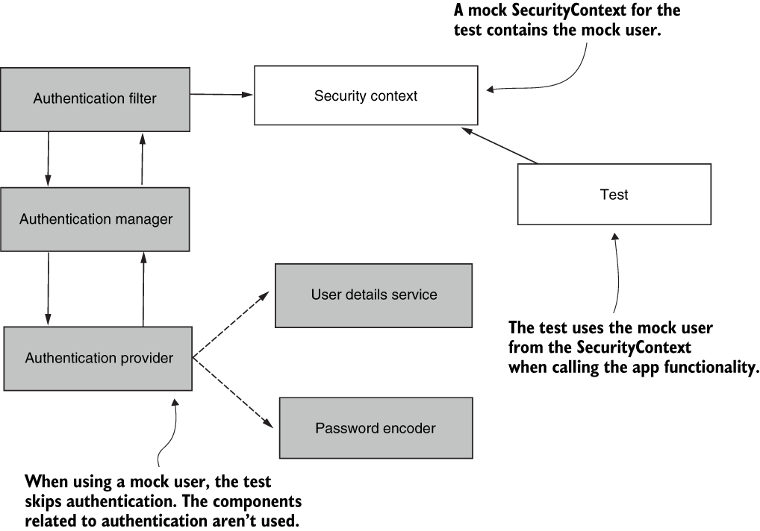
Integration testing
1
Notes:
Chapter Intro Slide (version P)
This slide should be used at the beginning of each “chapter” of your presentation (as introduced in the Agenda slide) to keep the audience aware of their place in the story and to help break things up. Change the text and chapter number accordingly. If you do not need a sub-head (the smaller text), delete it. Use different backgrounds for different chapter titles, try not to repeat a background.
Very short presentations (< ~10 slides) may not need Chapter Intro Slides.
There are multiple versions of this template with various white and black background images starting on slide 10.

Slide 26

manning.com
ctwvoxxed22
1
Notes:
Chapter Intro Slide (version P)
This slide should be used at the beginning of each “chapter” of your presentation (as introduced in the Agenda slide) to keep the audience aware of their place in the story and to help break things up. Change the text and chapter number accordingly. If you do not need a sub-head (the smaller text), delete it. Use different backgrounds for different chapter titles, try not to repeat a background.
Very short presentations (< ~10 slides) may not need Chapter Intro Slides.
There are multiple versions of this template with various white and black background images starting on slide 10.

Slide 27
laurspilca.com/blog
youtube.com/c/laurentiuspilca
@laurspilca
Laurentiu Spilca
Notes:
Elements (version 1)
Elements are used to give more detail to a set of ideas, they should all relate to the same topic.
For example, use this page for a list of deliverables, key roles on a project, phases of a project, or any topic that can be broken down into more specific examples.
Each section should have an icon that relates to the content of that specific element, no icon should be repeated on the same page, and they should all be the same colour.
Keep the text to 1-2 sentences and aim to have about the same amount of content under each element.

Slide 28
Notes:
Elements (version 1)
Elements are used to give more detail to a set of ideas, they should all relate to the same topic.
For example, use this page for a list of deliverables, key roles on a project, phases of a project, or any topic that can be broken down into more specific examples.
Each section should have an icon that relates to the content of that specific element, no icon should be repeated on the same page, and they should all be the same colour.
Keep the text to 1-2 sentences and aim to have about the same amount of content under each element.

